Slide 1
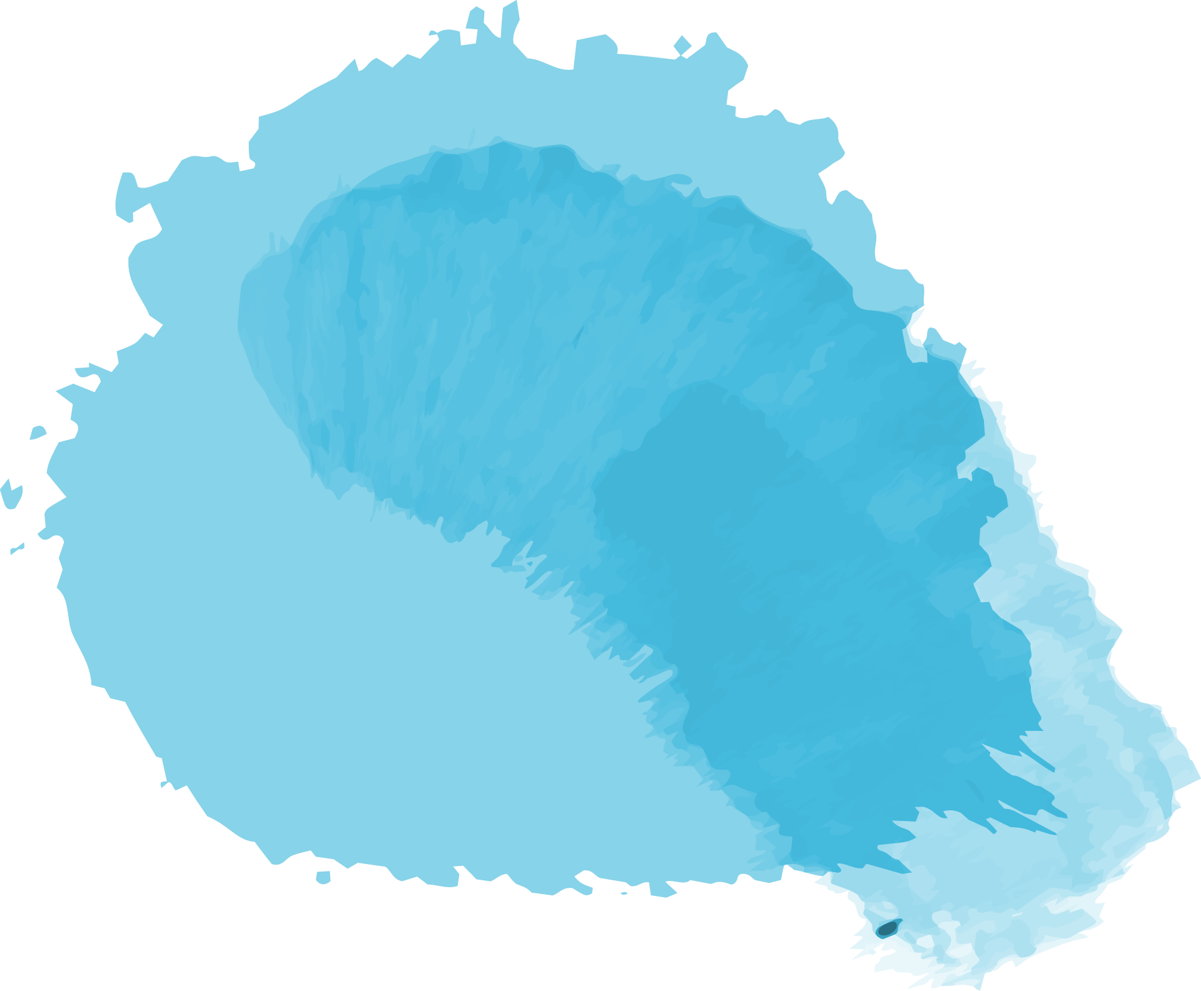


Data Science
Mini Project
Yuanxin Pang
20234570

Slide 2
01
Data analysis pipeline

Slide 3

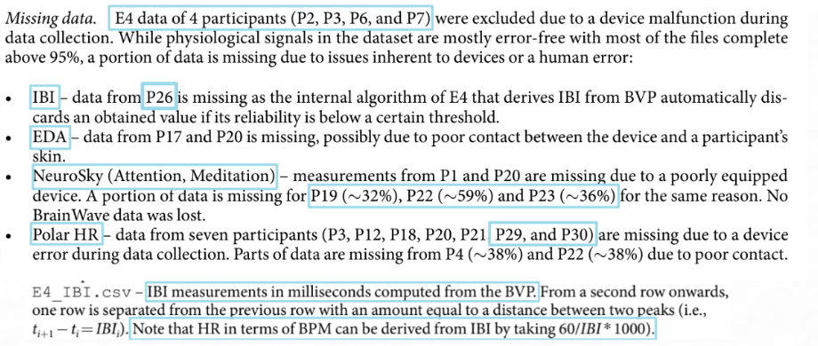
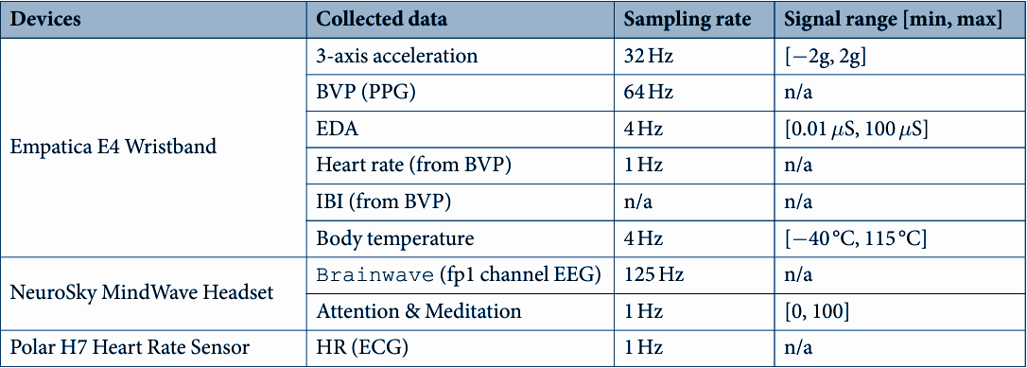

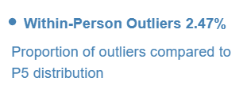
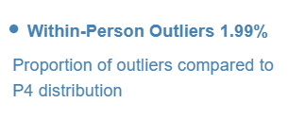
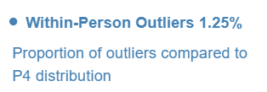
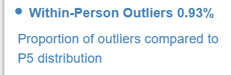
Data explore
User ID: [ 4 5 8 9 10 13 15 19 21 22 23 25 26 29 30 31]
Paper
MDExplorer
Notes:
In this slide, I want to introduce how and why I selected specific data from the entire dataset.
Data Selection Process
Left Table:
Because the training and test user sets are predefined, I searched for information in the provided paper, specifically in the paragraph discussing missing data. Several data types were excluded due to significant portions of missing data that couldn't be interpolated or handled within the given user set:
‘Polar HR’, ‘e4.IBI’, and ‘Attention & Meditation’ data were all excluded because they contained large amounts of missing data that couldn't be reliably interpolated or managed.
‘e4.HR’ and ‘Brainwave’ data were not used because managing the numerous and diverse features they presented was challenging.
Selected Data:
After careful consideration, I chose the following data for training:
‘e4.3-axis acceleration’
‘e4.BVP (PPG)’
‘e4.EDA’
‘e4.body temperature’
From the provided pickle file (pkl), I utilized the ‘rec.audio.left’ and ‘rec.audio.right’ audio data.
Data Exploration
After selecting the data, I used MDExplorer to gain a deeper understanding of the data distribution. This tool helped me uncover that each user’s sensor data contained a significant number of distribution outliers. Understanding these outliers was crucial for preprocessing and ensuring the robustness of the models.
Rationale Behind Data Selection
The rationale for excluding certain data types and focusing on others was driven by both the quality and the manageability of the data:
Quality of Data:
Missing Data: The excluded data types had significant missing values, making them unreliable for training robust models. These gaps couldn't be effectively filled through interpolation due to the extent and nature of the missing data.
Manageability:
Complexity: Handling an excessive number of features from ‘e4.HR’ and ‘Brainwave’ data would complicate the modeling process without necessarily improving performance. Simplifying the feature set helps in creating more interpretable and manageable models.
Focus on Reliable Sensors:
Selected Sensors: The chosen sensors (acceleration, BVP, EDA, body temperature, and audio) provided a balanced combination of physiological and behavioral signals, which are crucial for the predictive tasks.
Conclusion
By strategically selecting and exploring the data, I aimed to balance quality, complexity, and relevance, ensuring that the data used in training the models was both robust and manageable. This careful selection process was essential in achieving reliable and interpretable results in the subsequent analysis and modeling stages.

Slide 4
Outliers detection
Normalization
Augmentation
MFCCs
Notes:
So I decide to do something with the dataset, it includes 4 steps:
Outlier detection and removal
Data normalization
Data augmentation
Extract MFCC features

Slide 5

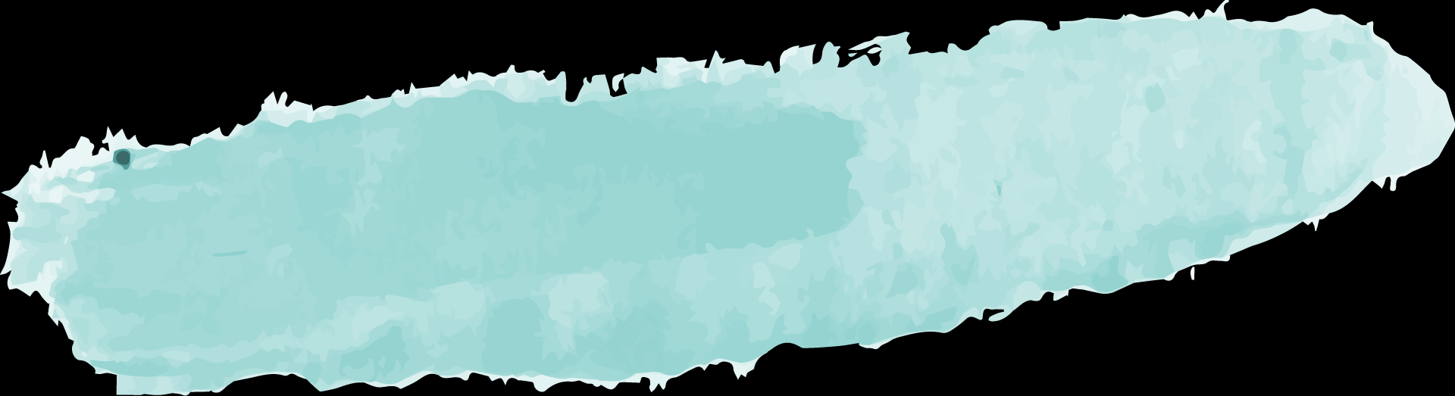
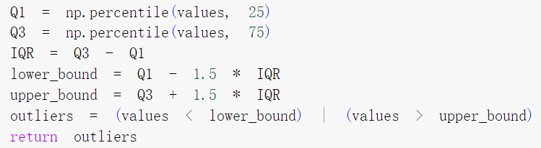
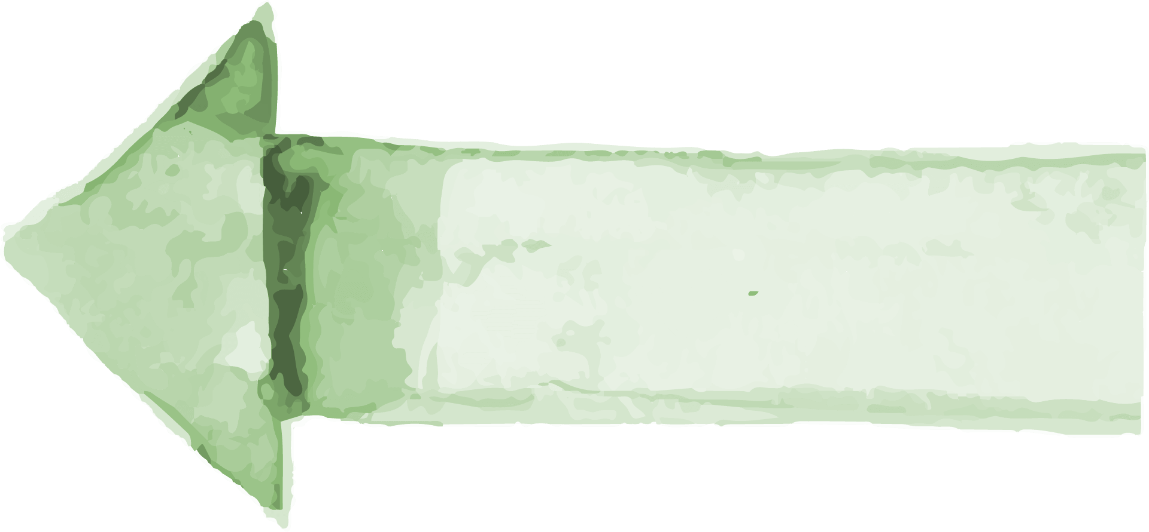
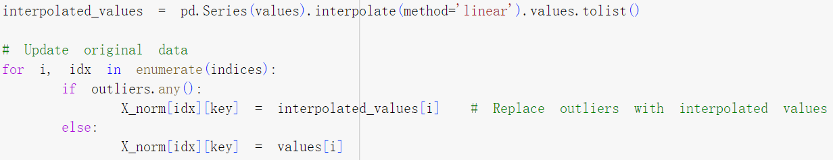
Outliers detection
SD > 0
Goals
SD = 0
Use 3 times standard deviation as threshold
SD(Standard Deviation)
Use box plot method
Notes:
The outlier detection relies on the data distribution. So I used the SD(standard deviation). There are two cases:
SD>0 : I user 3 times standard deviation as threshold
SD=0 : To avoid a divide zero error, I use box plot method to detect outliers.
After detecting the outliers, I use the linear interpolation method to update the outlier values.

Slide 6
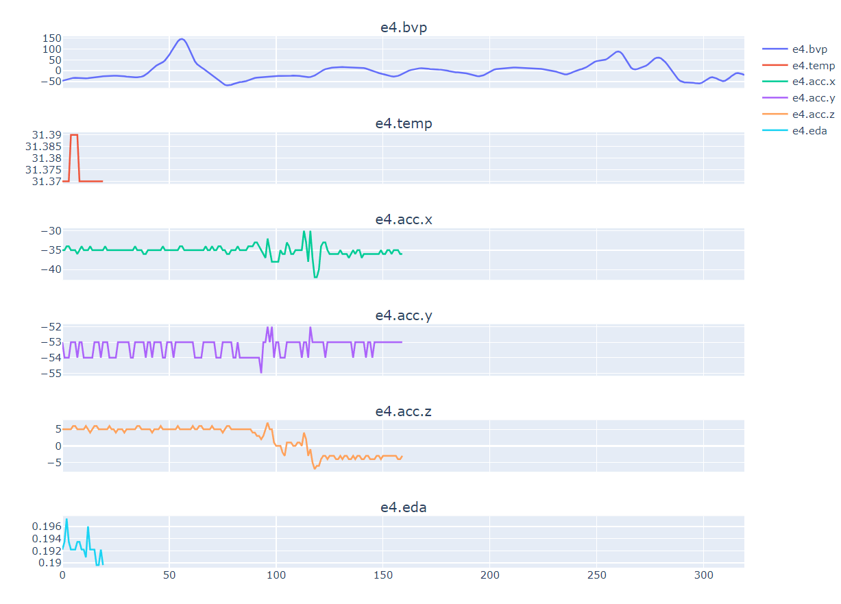
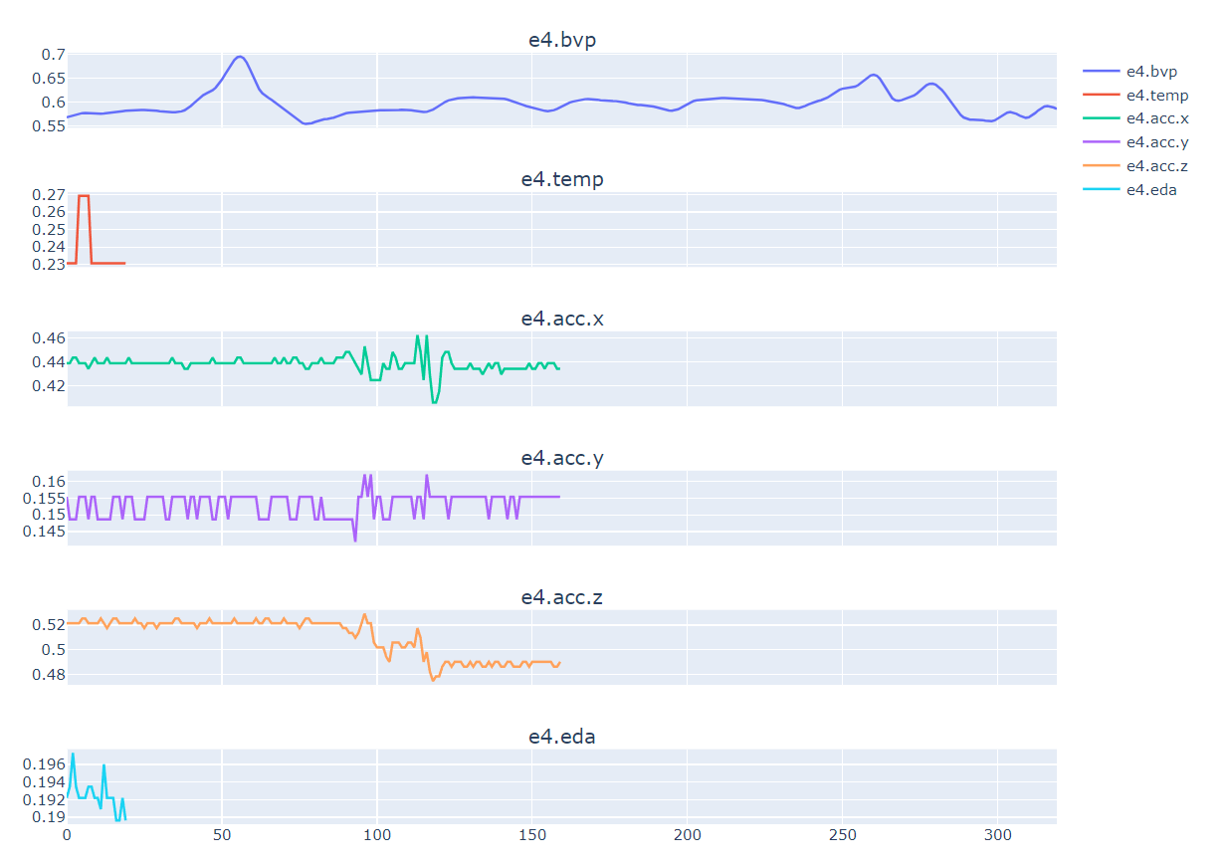
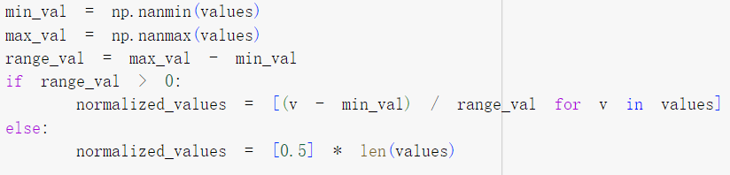
Normalization
Min-max normalization[1]
Notes:
Why Normalize?
I chose to normalize the data because the left figure illustrates that each dataset (e4.bvp, e4.temp, e4.acc.x, e4.acc.y, e4.acc.z) exhibits different ranges and limits. This variability can significantly influence prediction performance by causing certain features to dominate others in numerical scale, potentially biasing model training.
Whom Did I Normalize?
Subsequently, I normalized five datasets: e4.bvp, e4.temp, e4.acc.x, e4.acc.y, and e4.acc.z. However, I did not normalize e4.eda and the audio data. I will elaborate on the reasons for this decision in upcoming slides.
Method of Normalization
The normalization method employed was min-max normalization. This method was chosen for its simplicity and clarity, as well as its direct applicability with readily available code, as demonstrated in the accompanying code image.
Result of Normalization
The right figure displays the outcomes of the normalization process, showcasing the standardized distributions of the normalized data.

Slide 7
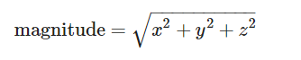
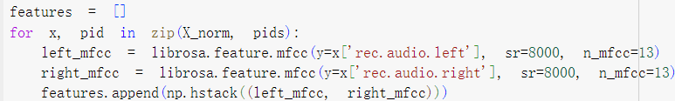
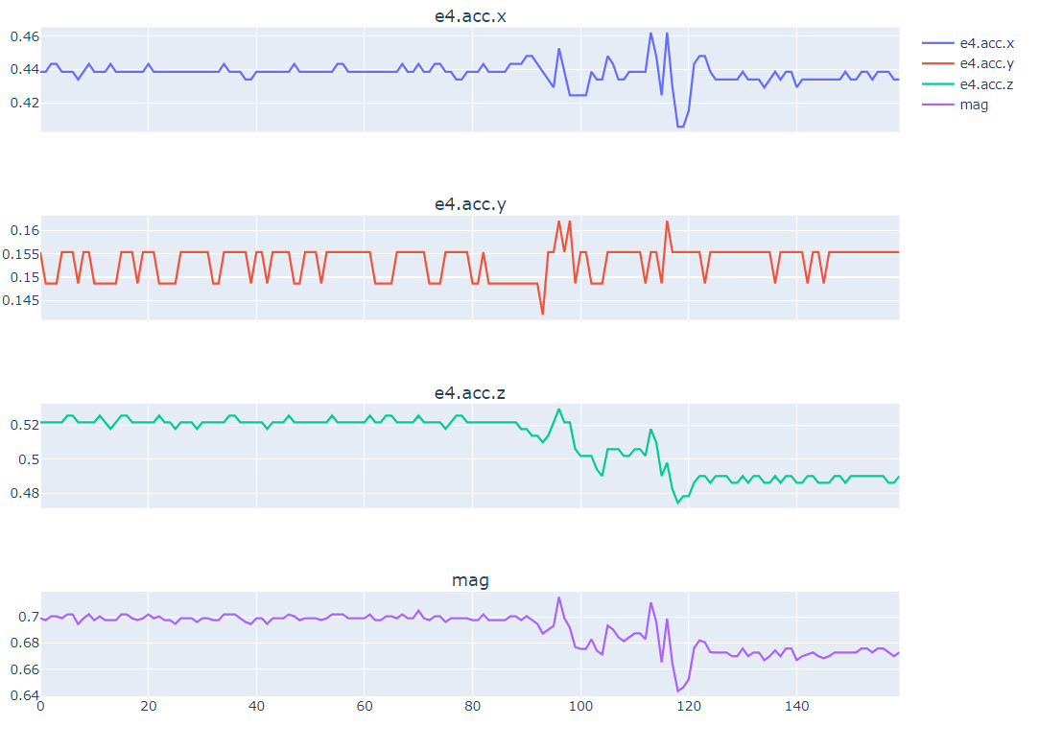
Augmentation
MFCCs
Notes:
To move on, I applied the magnitude augmentation from HW 8. You can see the ‘mag’(magnitude) represented in the purple line. I use this method is because I wanna make the data ‘stronger’ to recognize patterns.
For the audio data, I didn’t normalized them because I extract the MFCC features using the Librosa library. I used 13 mfcc features and combined the right and left channel together, so the final dimension of the ‘mfcc’ feature is 13 * 158 big.

Slide 8
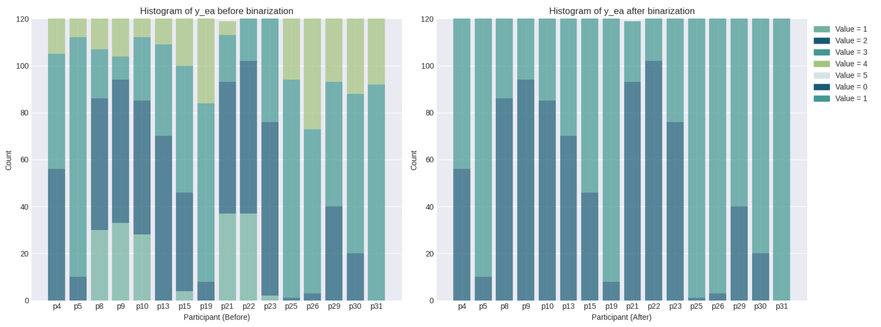
Labeling
Notes:
I want to say something about the label period. As we set the external_arousal <= 2 as 0 and others as 1(from figure left to figure right). What we should know is the label imbalance in the binary classification scenario. I will discuss this later.

Slide 9
02
Model choosing
Notes:
Then I want to talk about the model I chose for the training and testing.

Slide 10
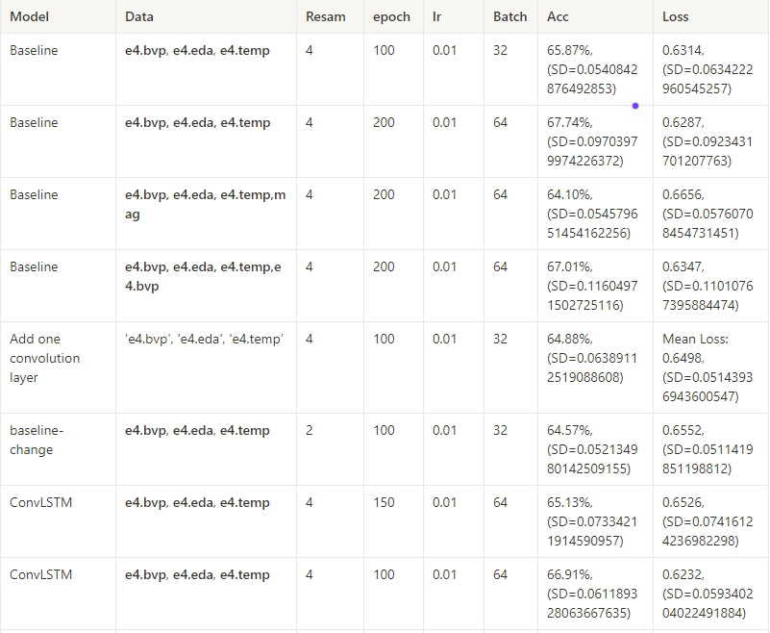
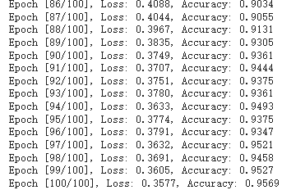
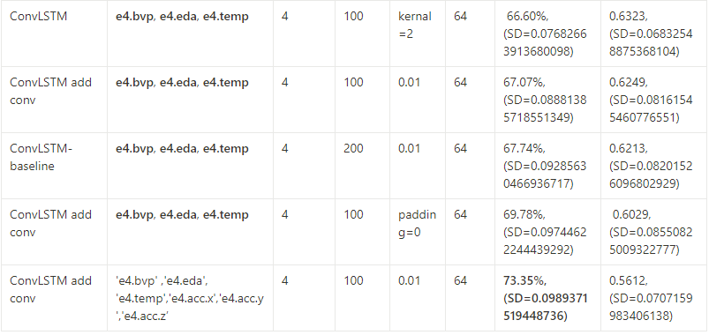
DNN & ML
Overfitting
Hard to fine-tune
Long time to train
Low Accuracy (highest : ~73%)[2]
criterion = nn.CrossEntropyLoss()
optimizer = optim.Adam([{'params': model.parameters(), 'weight_decay': 1e-5}], lr=0.01)
Notes:
ConvLSTM Model Challenges and Limitations
Initial Approach with ConvLSTM
Initially, I implemented a ConvLSTM model and incorporated convolutional layers, meticulously fine-tuning its hyperparameters to achieve the best performance. Despite these efforts, the model yielded a maximum accuracy of approximately 73%.
Identified Challenges:
During the training and testing phases, several issues became apparent:
Overfitting: At times, the model demonstrated severe overfitting, where the training loss approached 93%, indicating a disparity between training and validation performance.
Hyperparameter Tuning Difficulty: Given the complexity of managing numerous variables, fine-tuning the hyperparameters proved challenging, often requiring iterative adjustments and extended experimentation.
Training Duration: Due to the dataset's size and complexity, some experiments necessitated up to 20 minutes for training, underscoring the resource-intensive nature of model development.
Project Outcome and Reflection
Despite dedicated efforts throughout the project, the model's overall improvement plateaued at just 8%. This modest progress led me to question the effectiveness of the ConvLSTM approach in addressing the project's objectives satisfactorily.
Exploring Alternative Models
Considering the identified challenges, I am now exploring alternative models that may offer solutions to these issues:
Potential Solutions: Seeking models that mitigate overfitting, simplify hyperparameter tuning, and optimize computational efficiency without compromising performance.
Evaluation Criteria: Prioritizing models that can deliver more substantial improvements in accuracy and efficiency compared to the ConvLSTM approach.
Conclusion
In conclusion, while the ConvLSTM model provided valuable insights, its limitations in addressing overfitting, hyperparameter tuning complexity, and computational efficiency prompted me to explore alternative solutions. By evaluating and adopting alternative models, I aim to enhance both the accuracy and efficiency of the project outcomes.

Slide 11
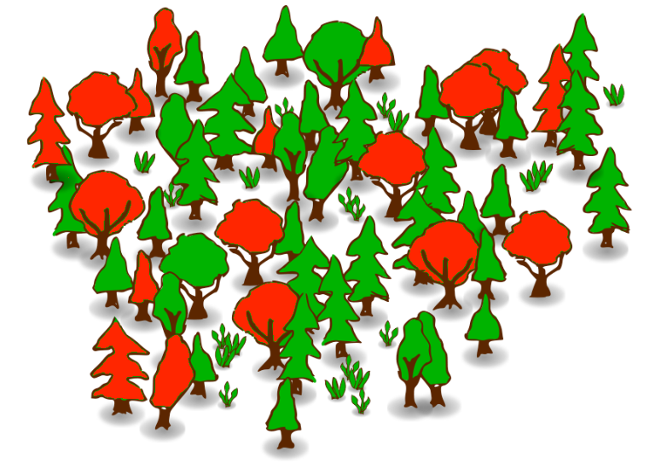
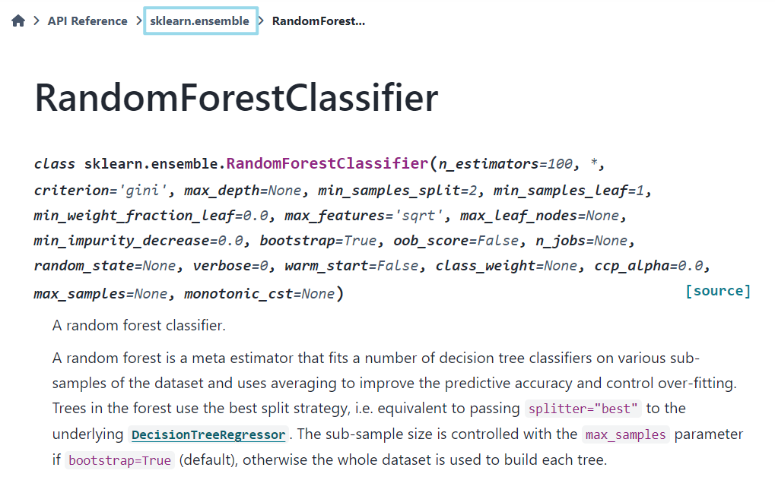
Random Forest
Random Forest works by constructing multiple decision trees during training and outputting the majority vote (classification) of the individual trees to improve predictive accuracy and control overfitting. Advantages[3]:
Reduces Overfitting
Easy to fine-tune
Feature importance
High Accuracy
n_estimators=100,
random_state=42
Notes:
Random forest is a machine learning algorithm that constructs multiple decision trees during training and combines their outputs through a majority vote (for classification tasks) to enhance predictive accuracy and mitigate overfitting. Its advantages include:
Overfitting Reduction: Combining multiple decision trees helps mitigate overfitting compared to individual trees.
Ease of Fine-Tuning: It offers straightforward mechanisms for adjusting hyperparameters to optimize model performance.
Feature Importance: Random forest provides insights into feature importance, aiding in understanding which variables contribute most significantly to predictions.
Given these advantages, I opted to use the random forest classifier from the scikit-learn API. I configured two key hyperparameters to tailor the model to my specific dataset and objectives.

Slide 12
03
Evaluation

Slide 13
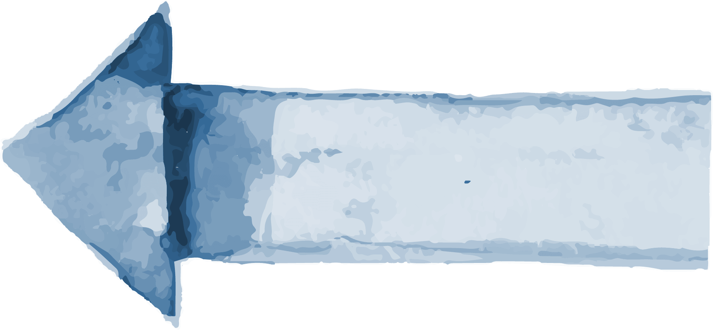
Results
Model 1(outlier)
Model 2(outlier+norm)
Accuracy:0.933
Accuracy:0.877
Model 3(outlier+norm)
Final model(Aug+norm+outlier)
Accuracy:0.935
Accuracy:0.95625
Accuracy: 0.915
Model *(Use only audio data)
Notes:
When I used the data after removing outliers, the accuracy reached 93%. Consequently, I applied min-max normalization to the E4 data, which resulted in a decrease in accuracy to 87%. Upon analyzing the cause, I hypothesized that the large range in the e4.eda data caused this drop in accuracy. Min-max normalization scaled the smaller values to be extremely small. Therefore, I conducted an experiment without normalizing e4.eda and found that the accuracy improved to 93.5%. Next, I included the 'mag' data column in the training, which led to a final accuracy of 95%. Additionally, when I used only the audio data, the accuracy reached 91%.

Slide 14
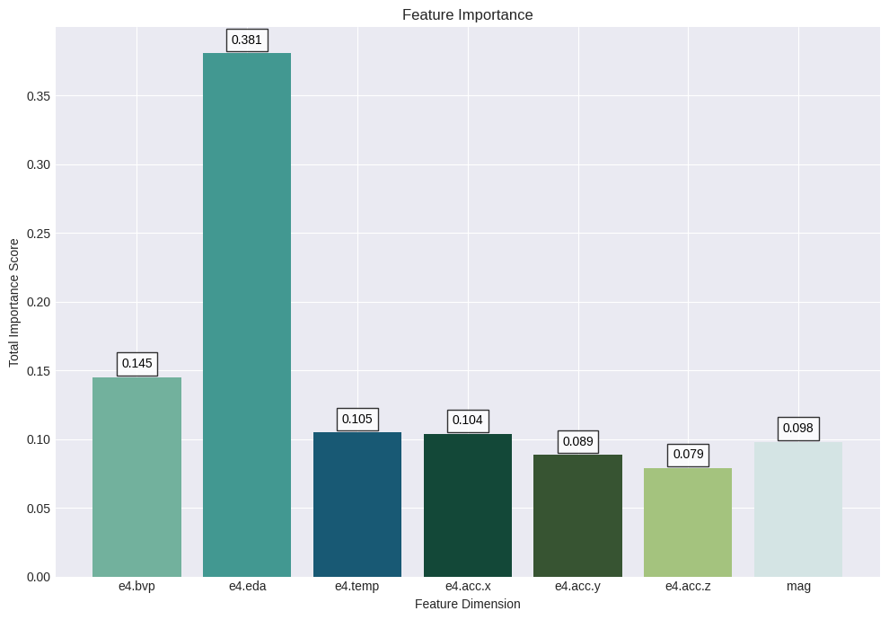
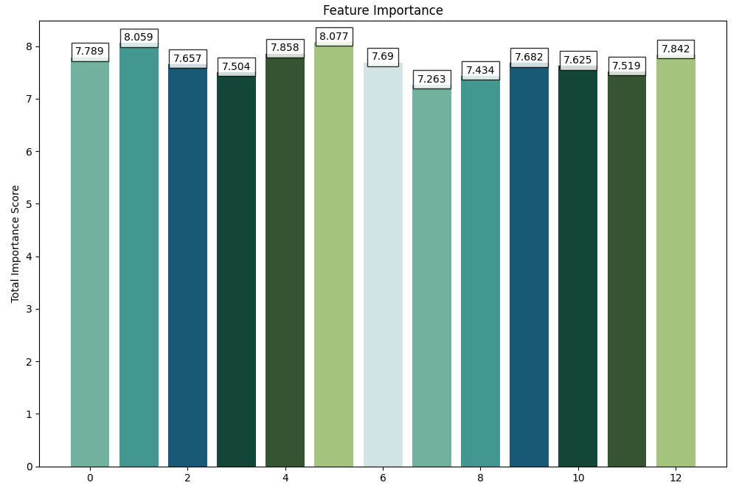

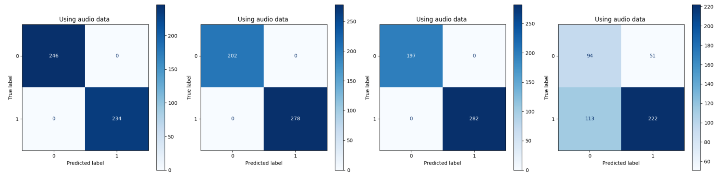
Evaluation
Final model feature importance
Model * feature importance
Final model confusion matrix
Notes:
I conducted feature importance analysis using the Random Forest classifier on both the E4 model and the audio model. The results showed that in the E4 data, e4.eda had the highest importance. This partially explains why normalizing e4.eda led to a decrease in accuracy, as it effectively reduced the significance of this crucial feature. On the other hand, in the audio data, the importance was distributed more evenly across the 13 features.
Given the high accuracy of the Random Forest algorithm, I used confusion matrices to evaluate the model's performance on the test set. I found that the model performed perfectly on the first three folds, but its performance was somewhat poor on the last fold.
This experiment has several limitations:
The audio and E4 data were not combined for prediction.
It is difficult to interpret what such high accuracy means. Despite verifying the data to rule out any errors, no issues were found. For more details, please refer to the notebook.

Slide 15
References
[1]V. N. G. Raju, K. P. Lakshmi, V. M. Jain, A. Kalidindi and V. Padma, "Study the Influence of Normalization/Transformation process on the Accuracy of Supervised Classification," 2020 Third International Conference on Smart Systems and Inventive Technology (ICSSIT), Tirunelveli, India, 2020, pp. 729-735, doi: 10.1109/ICSSIT48917.2020.9214160.
[2]Ordóñez, Francisco Javier, and Daniel Roggen. 2016. "Deep Convolutional and LSTM Recurrent Neural Networks for Multimodal Wearable Activity Recognition" Sensors 16, no. 1: 115. https://doi.org/10.3390/s16010115
[3]Boateng, Ernest Yeboah & Otoo, Joseph & Abaye, Daniel. (2020). Basic Tenets of Classification Algorithms K-Nearest-Neighbor, Support Vector Machine, Random Forest and Neural Network: A Review. Journal of Data Analysis and Information Processing. 08. 341-357. 10.4236/jdaip.2020.84020.
Notes:
These are the references I used for this project.

Slide 16
Thanks for listening!

Slide 17
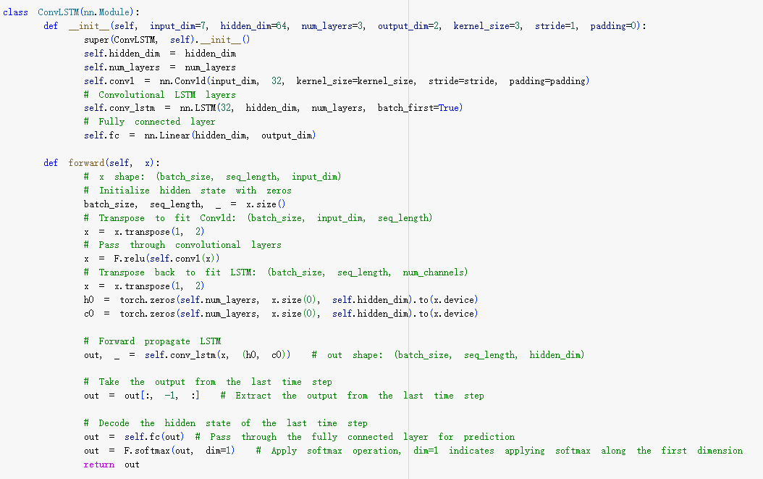
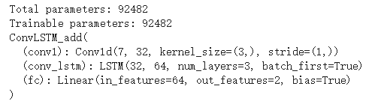
Appendix-ConvLSTM
ConvLSTM structure

Slide 18
Appendix-CodeReview
Visualise as many processing steps as I can.
Follow coding standards for consistency, readability, and comprehension.
Utilize code comments and textual explanations for clarity and understanding.

